Slide 1


Laptop Price Prediction
By
Vallam Vamshi Krishna
11625644
Advanced Data Analytics
Notes:
Hello, as a part of my Final Project for the course Data Analytics 1, I have worked on the Laptop Prices dataset to predict Laptop prices.

Slide 2
Contents
Introduction
Problem Statement
Statistical Approach
Conclusion
Notes:
I will be covering the Introduction, Problem Statements associated with the dataset, the statistical approach to work on the problem statements, and the conclusion.

Slide 3
Introduction
Laptop Prices have always been set based on the different specifications and configurations it contains.
We will be working on the Laptop Sales dataset to predict prices and compare means of groups.
We will use different statistical methods to find a solution.
Notes:
Different specifications and configurations in the laptop decide its price. Different statistical methods such as ANOVA, Regression, and Hypothesis Testing to work on the price prediction and comparison between different groups.

Slide 4
Problem Statement
To determine whether there is any significant difference between the average price of laptops based on the presence of Bundled Applications present in it at a 95% Confidence Level.
To Predict the Laptop price based on Screen Size, Battery Life, RAM, Processor Speed, Integrated Wireless, Hard Disk Size, and Bundled Applications.
Notes:
So, for our data, I will be working on different problem statements. The first problem statement is to determine whether there is any significant difference between the average price of laptops based on the presence of Bundled Applications present in it using a 95% confidence level. The second problem statement is to predict the Laptop price based on different specifications of a laptop.

Slide 5
Statistical Approach
Problem Statement 1
Hypothesis
Null Hypothesis, (Ho): There are no significant differences in the mean laptop prices based on the Bundled Applications.
Alternate Hypothesis, (Ha): There is a significant difference in the mean laptop prices based on the Bundled Applications.
Notes:
For problem statement 1 to compare the mean prices, I have used ANOVA. ANOVA is the statistical method that is used to compare means of two or more group values. I have framed Null Hypothesis and Alternate Hypothesis, Null Hypothesis states that there are no significant differences in the mean laptop prices based on the Bundled Applications. The Alternate Hypothesis is that there is a significant difference in the mean laptop prices based on Bundled Applications.

Slide 6
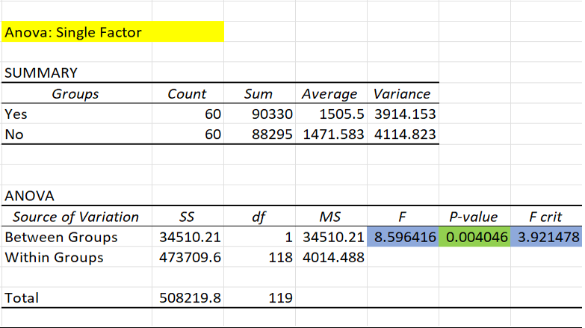
Using ANOVA
The F- statistic value is 8.59 which is greater than the F-critical value which is 3.92.
The p-value = 0.0040 which is less than the alpha value of 0.05
Since, the p-value is less than the alpha, we can reject the Null Hypothesis and accept the Alternate Hypothesis.
It means there is a significant difference in the mean laptop prices based on the Bundled Applications.
Notes:
By using ANOVA single factor in Microsoft Excel, we have got some statistical results. Our F statistic value is equal to 8.59 and the F-critical value is 3.921. The p-value is equal to 0.0040 and the alpha value is 0.05. Since, the F statistical value is less than the F-critical value and the p-value is less than the Alpha value, we can reject the Null Hypothesis and can conclude that the there is differences in the mean laptop prices based on the presence of Bundled Applications.

Slide 7
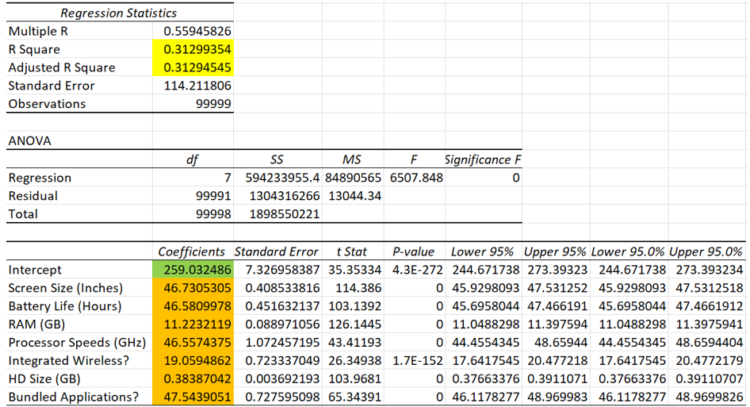
Problem Statement 2 Using Regression
Notes:
For the problem statement, I am predicting the laptop price based on certain specifications of the laptop. I have developed a Regression table using Microsoft Excel and the results are displayed above.

Slide 8
Regression Equation
Based on the Regression table of dataset we got our Regression Equation below:
Price=259.032 + 46.730*(Screen Size (Inches)) + 46.581*(Battery Life (Hours)) + 11.223*(RAM GB) + 46.557*(Processor Speeds (GHz) +19.06*(Integrated Wireless?) + 0.39*(HD Size (GB)) + 47.544*(Bundled Applications?)
Now, let’s predict the laptop price for Screen Size (Inches) = 18, Battery Life (Hours) = 8, RAM (GB) = 16, Processor Speeds (GHz) = 2.4, Integrated Wireless? = Yes, HD Size (GB) = 360, Bundled Applications? = Yes
Price=259.032 + 46.730*(18) + 46.581*(8) + 11.223*(16) + 46.557*(2.4) +19.06*(1) + 0.39*(360) + 47.544*(1) = 1968.936
We have predicted that the laptop price for the above specifications would be around 1968.936 from the above Regression Equation.
Notes:
By using the Regression table, I have developed the regression equation which is Price=259.032 + 46.730*(Screen Size (Inches)) + 46.581*(Battery Life (Hours)) + 11.223*(RAM GB) + 46.557*(Processor Speeds (GHz) +19.06*(Integrated Wireless?) + 0.39*(HD Size (GB)) + 47.544*(Bundled Applications?)
Now, I will be predicting the laptop price based on certain specifications like Screen Size (Inches) = 18, Battery Life (Hours) = 8, RAM (GB) = 16, Processor Speeds (GHz) = 2.4, Integrated Wireless? = Yes, HD Size (GB) = 360, Bundled Applications? = Yes. The price for the laptop is predicted as 1968.936.

Slide 9

Conclusion
We have compared the mean laptop prices for Bundled Applications are higher compared to the laptops that do not have Bundled Applications.
We can predict the laptop price based on the different specifications present in the dataset.
Notes:
To conclude, the mean laptop prices for Bundled Applications are higher compared to the laptops that do not have Bundled Applications. We have predicted the laptop price for certain specifications.

Slide 10

Notes:
Thank You !

